Slide 1
Player Rank - Quickness
Miguel Vidal

Slide 2
Definition of “Quick”
Combination of three measurements found for each player
Max Velocity
Max Acceleration
Average Sprint Speed
Quickness score produced by min-max normalization of above values.
Maximum score of 3
The higher the score, the ”quicker” the player.
Each metric weighted to a max value of 1

Slide 3
Pros and Cons of Quickness Score
Pros
Adds more context to how fast a player is instead of just ranking players on one metric.
Lessens the magnitude of one max sprint.
Adds value to sprint repeatability.
Acknowledges soccer is multidirectional (acceleration).
Cons
Data captured does not track players through an entire game (~60 min captured) so some running may not be captured.
Score normalizes data for one team.
Scores would be different if more teams/leagues were included.
Average sprint speed is biased towards players who may sprint fast, but only do it once.

Slide 4
Approach to Analysis
Calculate velocity and acceleration
Velocity – Square root of VX^2 + VY^2
VX and VY = Difference calculated for each row of player x and y position then divided by the time between each row.
Acceleration – Difference calculated for each row of player velocity divided by the time between each row.
Max sprint speed, max acceleration, and average sprint speed were then found for each player.
Sprinting was defined as any running greater than or equal to 7 m/s.
Min-max normalization calculated for each column then added for each player to determine Quickness Score.

Slide 5
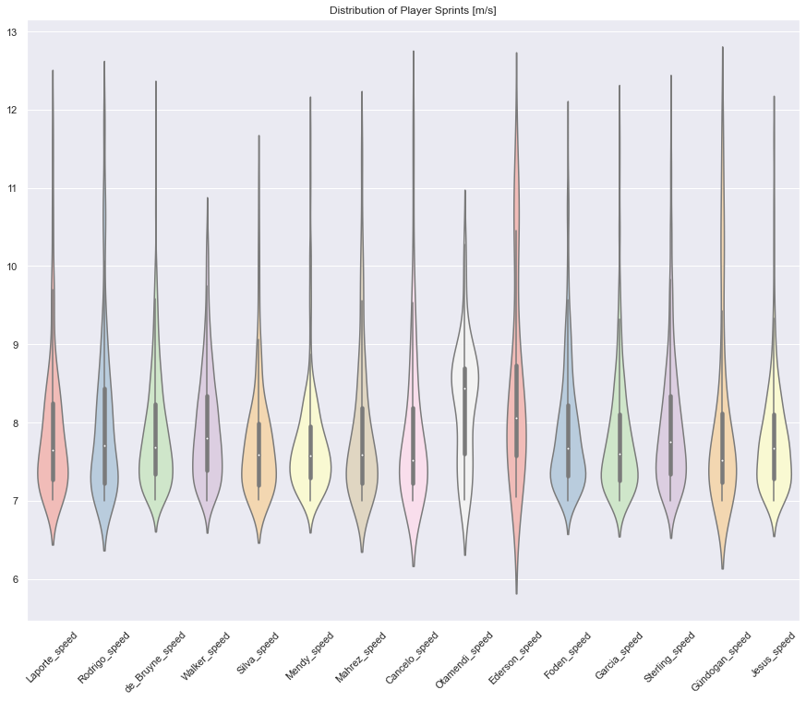
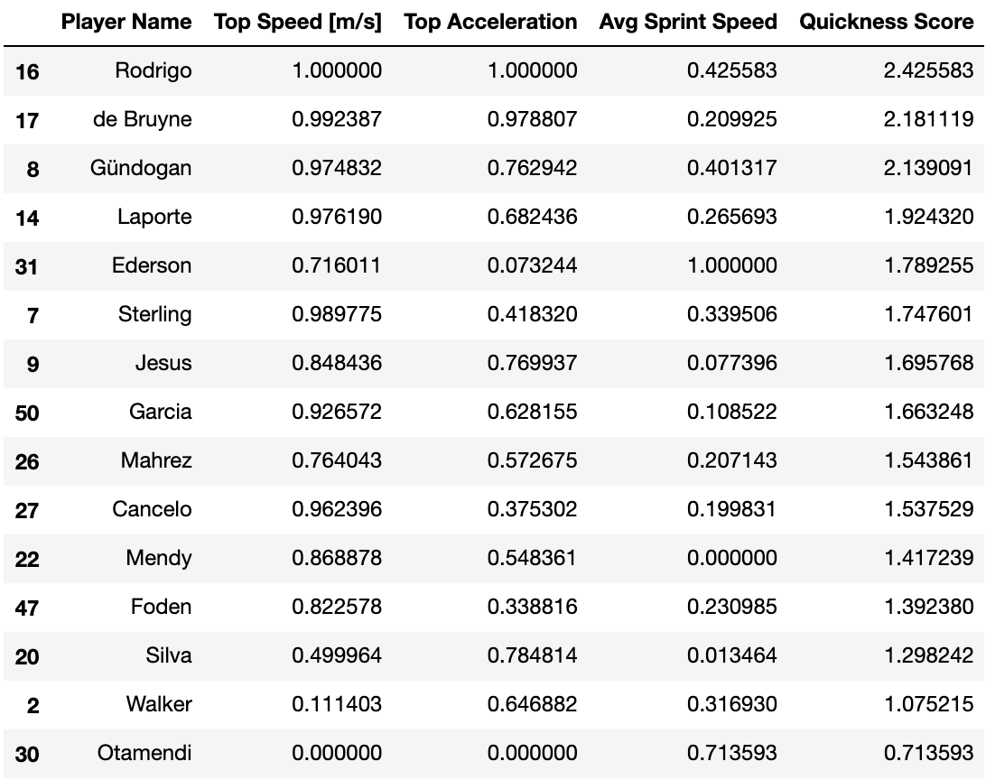
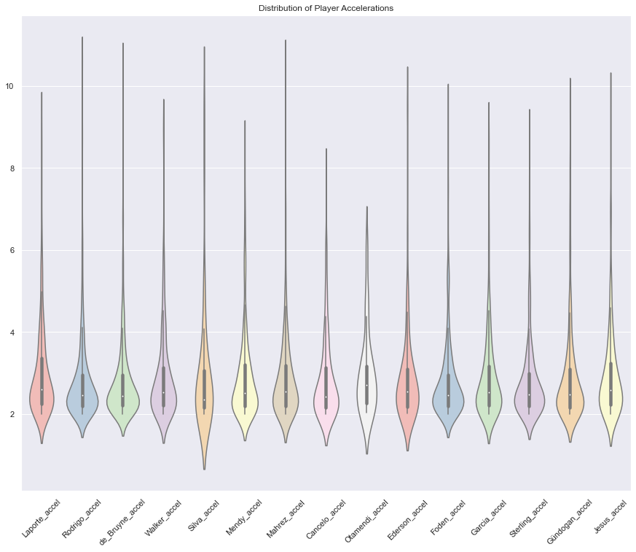
Results

Slide 6
Moving Forward
Validate analysis
Does analysis done using broadcast data match what is captured other forms of tracking data.
Context of game may not necessitate max sprint speed.
If embedded with team, sport scientist can record players’ sprint speed during physical testing.
Metrics from sport scientist can then be used to quantify sprints as a percentae of max speed.
Definition of quick can be improved.
Would like to include time it took to execute a pass.
Pass estimation in tracking data would then be validated against event data.
Add context to sprint
What occurred in the game 10 s before and after sprint occurred.

